Slide 1
Java

Slide 2
Why is Java a platform independent language?
Java language was developed in such a way that it does not depend on any hardware or software due to the fact that the compiler compiles the code and then converts it to platform-independent byte code which can be run on multiple systems.
The only condition to run that byte code is for the machine to have a runtime environment (JRE) installed in it

Slide 3
Why is Java not a pure object oriented language?
Java supports primitive data types - byte, boolean, char, short, int, float, long, and double and hence it is not a pure object oriented language.

Slide 4
Difference between Heap and Stack Memory in java. And how java utilizes this.
Stack memory is the portion of memory that was assigned to every individual program. And it was fixed. On the other hand, Heap memory is the portion that was not allocated to the java program but it will be available for use by the java program when it is required, mostly during the runtime of the program.
Java Utilizes this memory as -
When we write a java program then all the variables, methods, etc are stored in the stack memory.
And when we create any object in the java program then that object was created in the heap memory. And it was referenced from the stack memory.

Slide 5
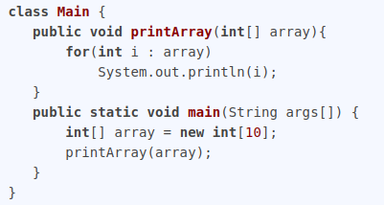
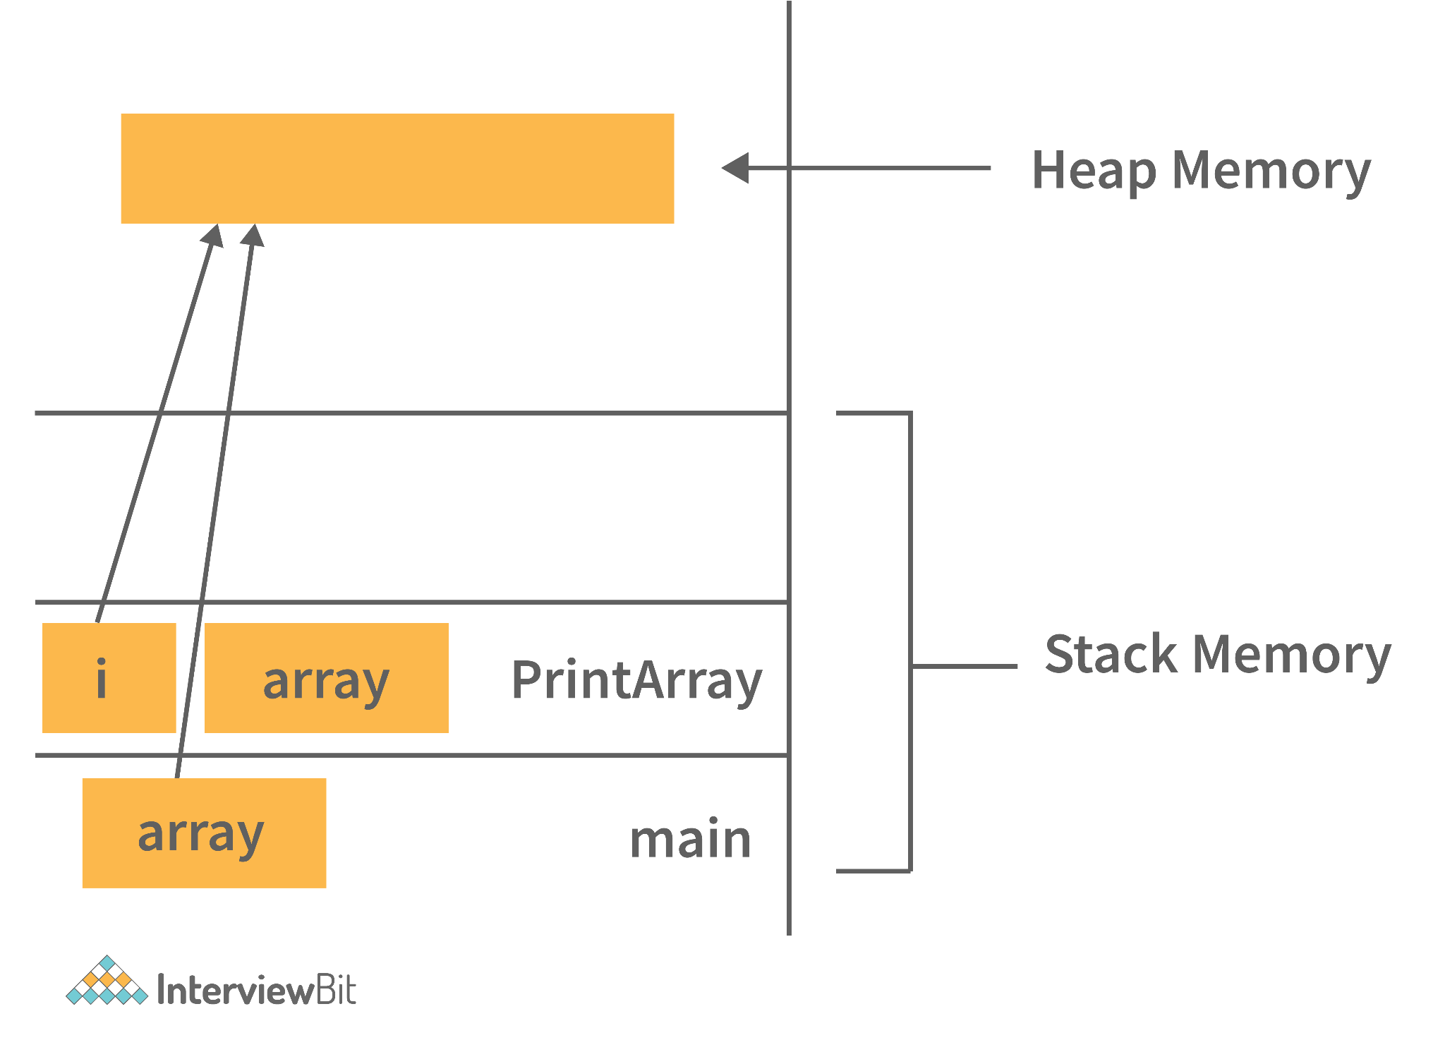
Example- Consider the below java program:

Slide 6
Can java be said to be the complete object-oriented programming language?
It is not wrong if we claim that java is the complete object-oriented programming language. Because Everything in Java is under the classes. And we can access that by creating the objects.
But also if we say that java is not a completely object-oriented programming language because it has the support of primitive data types like int, float, char, boolean, double, etc.
Now for the question: Is java a completely object-oriented programming language? We can say that - Java is not a pure object-oriented programming language, because it has direct access to primitive data types. And these primitive data types don't directly belong to the Integer classes.

Slide 7
How is Java different from C++?
C++ is only a compiled language, whereas Java is compiled as well as an interpreted language.
Java programs are machine-independent whereas a c++ program can run only in the machine in which it is compiled.
C++ allows users to use pointers in the program. Whereas java doesn’t allow it. Java internally uses pointers.
C++ supports the concept of Multiple inheritances whereas Java doesn't support this. And it is due to avoiding the complexity of name ambiguity that causes the diamond problem.

Slide 8
What is Exception?
An exception is an unexpected or abnormal condition that interrupts the normal execution of a program.
In computer programming, an exception is an event or condition that interrupts the normal flow of a program's execution. It occurs when an unexpected or exceptional situation arises that the program cannot handle or recover from automatically. Exceptions are commonly used to handle errors, exceptional cases, or other unusual conditions that may occur during the execution of a program.

Slide 9
What is Exception Handling
Exception handling refers to the process of managing and responding to exceptions that occur during the execution of a program. It involves detecting when an exception occurs, transferring control to an appropriate exception handler, and taking necessary actions to handle the exception. Exception handling helps to prevent program crashes and allows for graceful recovery or alternative behaviors when exceptional situations arise.

Slide 10
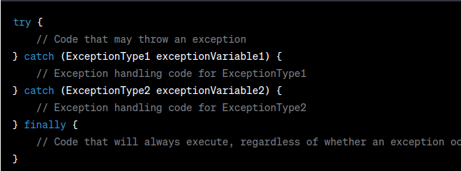
Example for Exception Handling

Slide 11
What is Error Handling?
Error handling refers to the process of managing and responding to errors that occur during program execution to prevent crashes and unexpected behaviors.
In programming, error handling typically involves using constructs like try-catch blocks, error codes, error objects, assertions, or other mechanisms provided by the programming language or framework. The goal of error handling is to gracefully handle errors, provide meaningful error messages or logging, and take appropriate actions to ensure the program's stability and reliability.

Slide 12
What is different between Error Handling and Exception Handling?
Exception handling is used to manage and recover from unexpected conditions during the execution of a Java program, while error handling deals with critical and unrecoverable issues that may lead to program termination.
Exceptions: Exceptions in Java represent unexpected or exceptional conditions that occur during the normal execution of a program. Exceptions are typically recoverable and can be caught and handled using try-catch blocks. They are intended to address situations where the program can reasonably recover and continue running.
Errors: Errors, on the other hand, represent severe and typically unrecoverable problems that usually arise from the environment or the Java runtime system itself. Errors indicate serious issues such as OutOfMemoryError, StackOverflowError, or other critical conditions that are not intended to be caught and recovered from. Errors are usually fatal and typically lead to program termination.

Slide 13
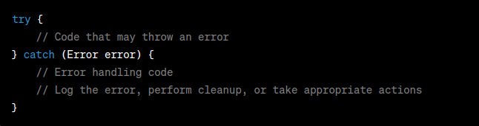
Example for Error Handling
In this example, the code that may produce an error is enclosed within the try block. If an error occurs, such as an OutOfMemoryError, it is caught by the catch block that specifies the type of error to handle (in this case, Error). Within the catch block, you can write code to handle the error, such as logging the error message, performing necessary cleanup operations, or taking other appropriate actions.

Slide 14
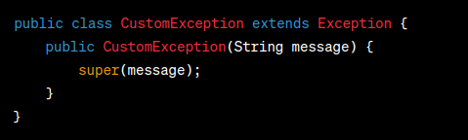
What is Custom Exception
Custom exception refers to a user-defined exception class that extends the standard Exception or one of its subclasses. By creating custom exceptions, developers can handle specific exceptional scenarios that are not covered by the built-in exceptions provided by Java.
To create a custom exception in Java, you typically define a new class that extends the Exception or one of its subclasses, such as RuntimeException. This custom exception class can have additional fields, methods, and constructors to suit the specific needs of the exceptional situation it represents.

Slide 15
What is Exception Propagation
Exception propagation refers to the process by which an exception is passed from one method to another or from one level of the call stack to another during program execution.
When an exception occurs within a method, it is typically thrown using the throw keyword. The thrown exception is then propagated up the call stack, searching for an appropriate exception handler that can catch and handle the exception. If an exception is not caught within a method, it will be propagated to the calling method, and the process continues until either an exception handler is found or the exception reaches the top level of the call stack.

Slide 16
What is checked and unchecked exceptions in terms of propagation
Exceptions are classified as checked exceptions and unchecked exceptions, and they differ in terms of how they propagate through method calls:
Checked Exceptions: Checked exceptions are exceptions that must be declared or caught. These exceptions are typically anticipated and expected to occur in certain situations. When a method throws a checked exception, any calling method is required to either handle the exception using a try-catch block or declare the exception in its own method signature using the throws keyword. This ensures that checked exceptions are explicitly acknowledged and dealt with by the calling code. Examples of checked exceptions include IOException, SQLException, and ClassNotFoundException.
Unchecked Exceptions: Unchecked exceptions, also known as runtime exceptions, do not require explicit handling or declaration. These exceptions are usually caused by programming errors, such as invalid method arguments, null references, or arithmetic overflows. Unchecked exceptions are not checked by the compiler during compilation, so the calling code is not required to catch or declare them. If an unchecked exception is not caught and handled, it will propagate up the call stack until it reaches an appropriate exception handler or causes the program to terminate. Examples of unchecked exceptions include NullPointerException, ArrayIndexOutOfBoundsException, and IllegalArgumentException

Slide 17
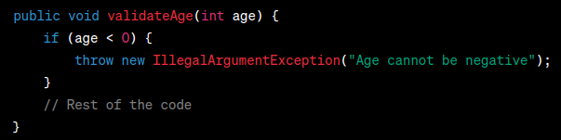
What is throw
The throw keyword is used to explicitly throw an exception. When an exceptional condition occurs in a program and the developer wants to indicate that condition by throwing an exception, the throw keyword is used to do so.
The general syntax for using throw is as follows:

Slide 18

Specify the exceptions that a method may throw
Specify the exceptions that a method may throw by including them in the method's signature using the throws keyword. This informs callers of the method about the exceptions they need to handle or declare in their own code.
The syntax for specifying thrown exceptions in a method declaration is as follows:

Slide 19
What is OOPS?
Object-Oriented Programming is a methodology or paradigm to design a program using classes and objects.
It simplifies software development and maintenance by providing some concepts: Object. Class.
Object-Oriented Programming System is the programming technique to write programs based on the real-world objects. The states and behaviors of an object are represented as the member variables and methods. In OOPS programming programs are organized around objects and data rather than actions and logic.

Slide 20
What is the Class?
A class is a group of objects which have common properties. It is a template or blueprint from which objects are created. In short, a class is the specification or template of an object.

Slide 21
What is Abstraction?
Abstraction in Java refers to hiding the implementation details of a code and exposing only the necessary information to the user. It provides the ability to simplify complex systems by ignoring irrelevant details and reducing complexity.

Slide 22
What is Encapsulation?
Encapsulation refers to combining data and associated functions as a single unit. In OOP, data and functions operating on that data are combined together to form a single unit, which is referred to as a class.
Encapsulation is the technique whereby the object's state is hidden from the outer world and a set of public methods for accessing this state are exposed. When each object keeps its state private inside a class, we can say that encapsulation was achieved. This is why encapsulation is also referenced as the data-hiding mechanism.
Encapsulation has a number of important advantages such as loosely coupled, reusable, secure, and easy to test code.
In Java, encapsulation is implemented via the access modifiers - public, private, and protected.

Slide 23
What is Inheritance?
The Inheritance is a process of obtaining the data members and methods from one class to another class, plus can have its own is known as inheritance. It is one of the fundamental features of object-oriented programming.
Super Class: The class whose features are inherited is known as a superclass (or a base class or a parent class).
Sub Class: The class that inherits the other class is known as a subclass(or a derived class, extended class, or child class). The subclass can add its own fields and methods in addition to the superclass fields and methods.
Why multiple inheritance is not supported in java?
To reduce the complexity and simplify the language, multiple inheritances is not supported in java.

Slide 24
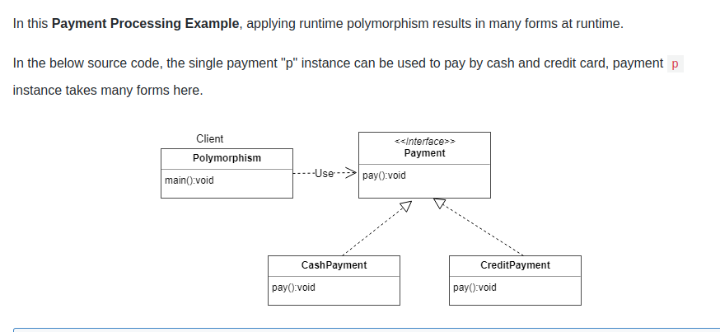
What is Polymorphism
The process of representing one form in multiple forms is known as Polymorphism.

Slide 25
Types of Polymorphism in Java
Compile time polymorphism or method overloading or static banding
Runtime polymorphism or method overriding or dynamic binding
When a type of object is determined at a compiled time(by the compiler), it is known as static binding.
When a type of object is determined at run-time, it is known as dynamic binding.
Method Overloading: changing no. of arguments or the data type of arguments Method overriding is a process in which a call to an overridden method is resolved at runtime rather than compile-time.

